Slide 1

CERTIFICATE III IN AUTOMOTIVE REPAIR & MAINTENANCE
SUBJECT: Automotive Engineering Practice
By Ibrahim siraj
Maldives polytechnic

Slide 2
Automotive Engineering Practice
Chapter 2 Identify Different Parts And Their Functions Of Engines
Internal combustion (IC) engines convert chemical energy in fuel into mechanical work.
Two main types:
Petrol (Gasoline) Engines
Diesel Engines
Both are widely used in transportation, power generation, and industrial applications.
By Ibrahim siraj
Maldives polytechnic

Slide 3
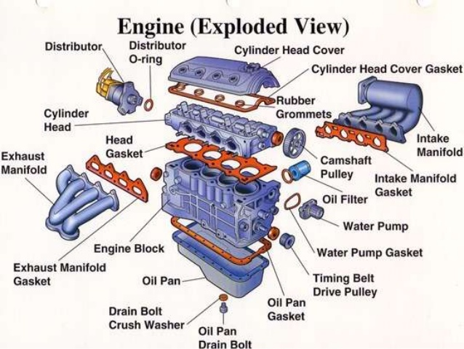
Automotive Engineering Practice
Chapter 2 Identify Different Parts And Their Functions Of Engines
By Ibrahim siraj
Maldives polytechnic

Slide 4
Automotive Engineering Practice
Chapter 2 Identify Different Parts And Their Functions Of Engines
Disassemble and Assemble the Engine
Timing of the Engine
Engine timing is the precise synchronization between an engine's crankshaft (pistons) and camshaft (valves), managed by a timing belt or chain. It ensures valves open/close at the correct moment relative to piston position, optimizing combustion and preventing engine damage. It includes valve timing and ignition timing (spark plug firing)
By Ibrahim siraj
Maldives polytechnic

Slide 5
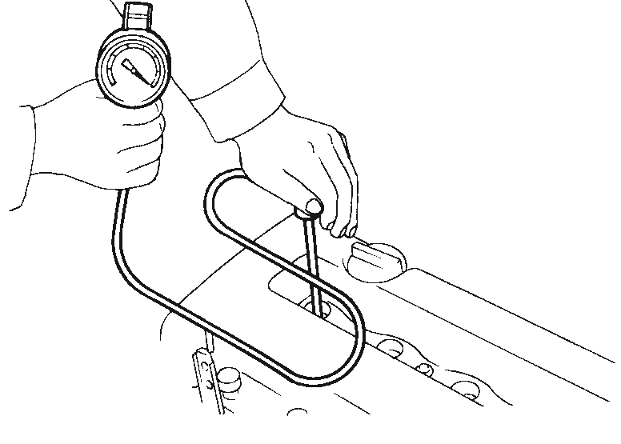
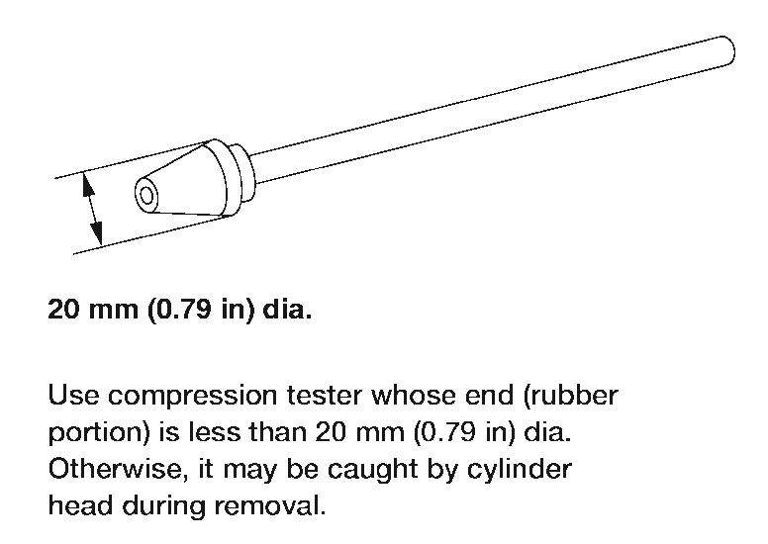
Automotive Engineering Practice
Chapter 2 Identify Different Parts And Their Functions Of Engines
Disassemble and Assemble the Engine
Measurement of Compression Pressure
Warm up engine.
Turn ignition switch OFF.
Release fuel pressure.
Refer to EC-40, “Releasing Fuel Pressure”.
Remove ignition coils.
Remove spark plugs.
Clean area around plug with compressed air before removing the spark plug.
Attached a compression tester to NO 1cylinder
Depress accelerator pedal fully to keep throttle valve wide open
Crank engine and record highest gauge indication
Repeat the measurement on each cylinder as shown above
SEM973E
QG15DE
Standard
1,372 (13.720, 13.99, 198.9)/350
Minimum
1,176 (11.759, 11.99, 170.5)/350
Maximum allowable difference between cylinders
98 (0.98, 1.0, 14)/350
AEM308
By Ibrahim siraj
Maldives polytechnic

Slide 6
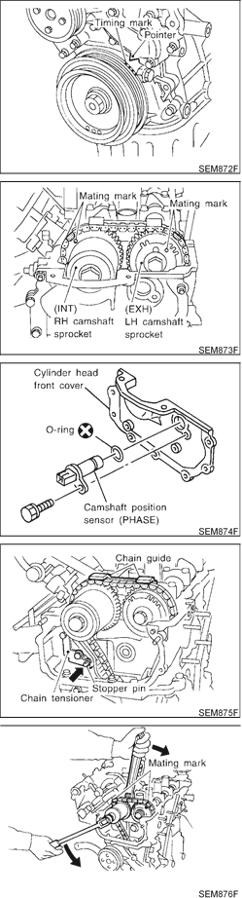
Automotive Engineering Practice
Chapter 2 Identify Different Parts And Their Functions Of Engines
Disassemble and Assemble the Engine
Timing Chain
Set No. 1 piston at TDC on its compression stroke.
Rotate crankshaft until mating mark on camshaft sprocket is set at position indicated in figure at left
Remove timing chain guide from camshaft bracket.
Attach a suitable stopper pin to chain tensioner.
Remove chain tensioner
Before assemble inspect and wash the parts for any damage of cavitation
By Ibrahim siraj
Maldives polytechnic

Slide 7
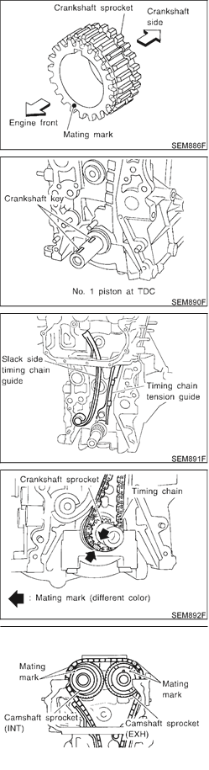
Automotive Engineering Practice
Chapter 2 Identify Different Parts And Their Functions Of Engines
Disassemble and Assemble the Engine
Timing Chain Installation
Install crankshaft sprocket on crankshaft.
Make sure mating marks on crankshaft sprocket face front of engine.
Position crankshaft so that No. 1 piston is at TDC and key way is at 12 o’clock. Install slack side timing chain guide and timing chain tension guide.
Install timing chain on crankshaft sprocket.
Support chain with a suitable tool to keep the mating mark aligned.
+ Set timing chain by aligning its mating mark with that on the crankshaft sprocket.
+ Make sure sprocket’s mating mark faces engine front.
Install camshaft sprocket.
Set timing chain by aligning mating marks with those of camshaft sprockets.
By Ibrahim siraj
Maldives polytechnic

Slide 8
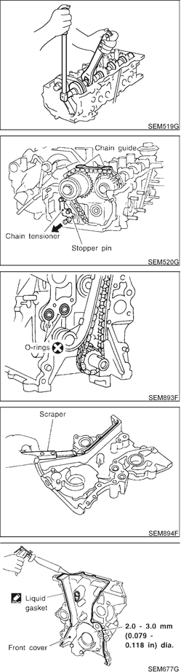
Automotive Engineering Practice
Chapter 2 Identify Different Parts And Their Functions Of Engines
Disassemble and Assemble the Engine
Timing Chain Installation
Install camshaft sprocket bolts and tighten them to correct torque.
Apply new engine oil to bolt threads and seat surface.
Install chain tensioner.
Before installing chain tensioner, insert a suitable pin into pin hole of chain tensioner.
+ After installing chain tensioner, remove the pin.
By Ibrahim siraj
Maldives polytechnic

Slide 9
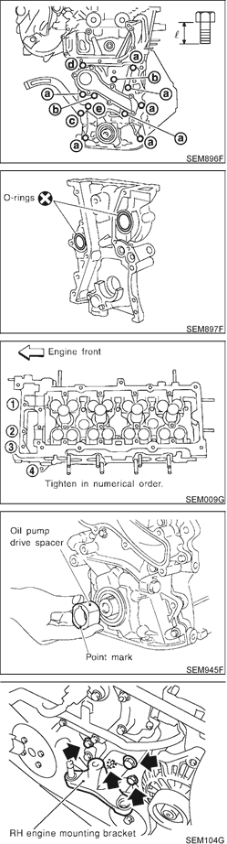
Automotive Engineering Practice
Chapter 2 Identify Different Parts And Their Functions Of Engines
Disassemble and Assemble the Engine
Install cylinder head bolts at engine front side
+ Tightening procedure
Tightening bolts (1 - 4) to 6.3 to 8.3 N·m (0.64 to 0.85 kg-m, 55.8 to 73.5 in-lb).
Install oil pump drive spacer
Install water pump and water pump pulley. Refer to LC-14, “Water Pump”.
Install idler pulley and bracket.
Install RH engine mounting bracket.
Install RH engine mounting.
Install oil strainer.
Install oil pan. Refer to EM-21, “Installation”.
Install crankshaft pulley.
By Ibrahim siraj
Maldives polytechnic

Slide 10
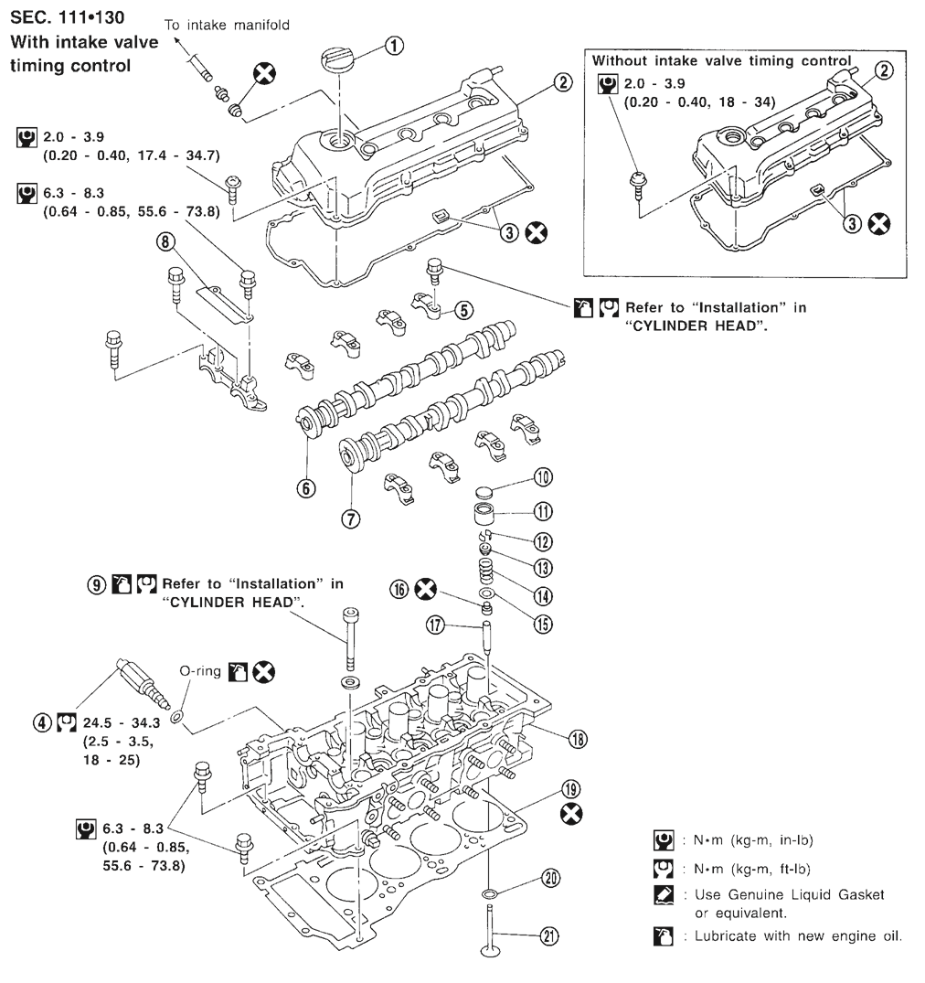
Automotive Engineering Practice
Chapter 2 Identify Different Parts And Their Functions Of Engines
Disassemble and Assemble the Engine
Install cylinder head bolts at engine front side
By Ibrahim siraj
Maldives polytechnic

Slide 11
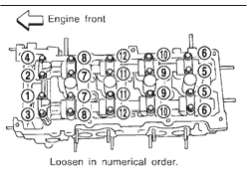
Automotive Engineering Practice
Chapter 2 Identify Different Parts And Their Functions Of Engines
Disassemble and Assemble the Engine
Install cylinder head bolts at engine front side
By Ibrahim siraj
Maldives polytechnic

Slide 12
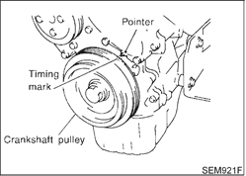
Automotive Engineering Practice
Chapter 2 Identify Different Parts And Their Functions Of Engines
Disassemble and Assemble the Engine
Valve Clearance
CHECKING _{NJEM0041S01}
Check valve clearance while engine is warm and not running.
Remove rocker cover.
Remove all spark plugs.
Set No. 1 cylinder at TDC on its compression stroke. + Align pointer with TDC mark on crankshaft pulley.
+ Check that valve lifters on No. 1 cylinder are loose and valve lifters on No. 4 are tight.
+ If not, turn crankshaft one revolution (360°) and align as described above.
By Ibrahim siraj
Maldives polytechnic

Slide 13
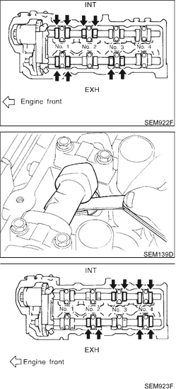
Automotive Engineering Practice
Chapter 2 Identify Different Parts And Their Functions Of Engines
Disassemble and Assemble the Engine
Valve Clearance
Check only those valves shown in the figure.
Using a feeler gauge, measure clearance between valve lifter and camshaft.
+ Record any valve clearance measurements which are out of specification. They will be used later to determine the required replacement adjusting shim.
Valve clearance for checking (Hot):
Intake 0.21 - 0.49 mm (0.008 - 0.019 in)
Exhaust 0.30 - 0.58 mm (0.012 - 0.023 in)
Turn crankshaft one revolution (360°) and align mark on crankshaft pulley with pointer.
Check only those valves shown in the figure.
+ Use the same procedure as mentioned in step 4.
If all valve clearances are within specification, install the following parts:
By Ibrahim siraj
Maldives polytechnic

Slide 14
Automotive Engineering Practice
Chapter 2 Identify Different Parts And Their Functions Of Engines
Disassemble and Assemble the Engine
Crankshaft
Install signal plate to crankshaft.
Set main bearings in their proper positions on cylinder block and main bearing cap.
+ Confirm that correct main bearings are selected by using Method A or Method B. Refer to EM-59.
+ Apply new engine oil to bearing surfaces.
Install crankshaft and main bearing caps and tighten bolts to the specified torque.
+ Apply new engine oil to the bolt thread and seat surface. + Prior to tightening bearing cap bolts, shift crankshaft back and forth to properly seat the bearing caps. + Tighten bearing cap bolts gradually in two or three stages. Start with center bearing and move outward as shown in figure.
+ After securing bearing cap bolts, make sure crankshaft turns smoothly by hand.
Measure crankshaft end play. Crankshaft end play:Standard0.060 - 0.220 mm (0.0024 - 0.0087 in)Limit0.3 mm(0.012 in)
If beyond the limit, replace thrust bearing with new ones.
By Ibrahim siraj
Maldives polytechnic

Slide 15
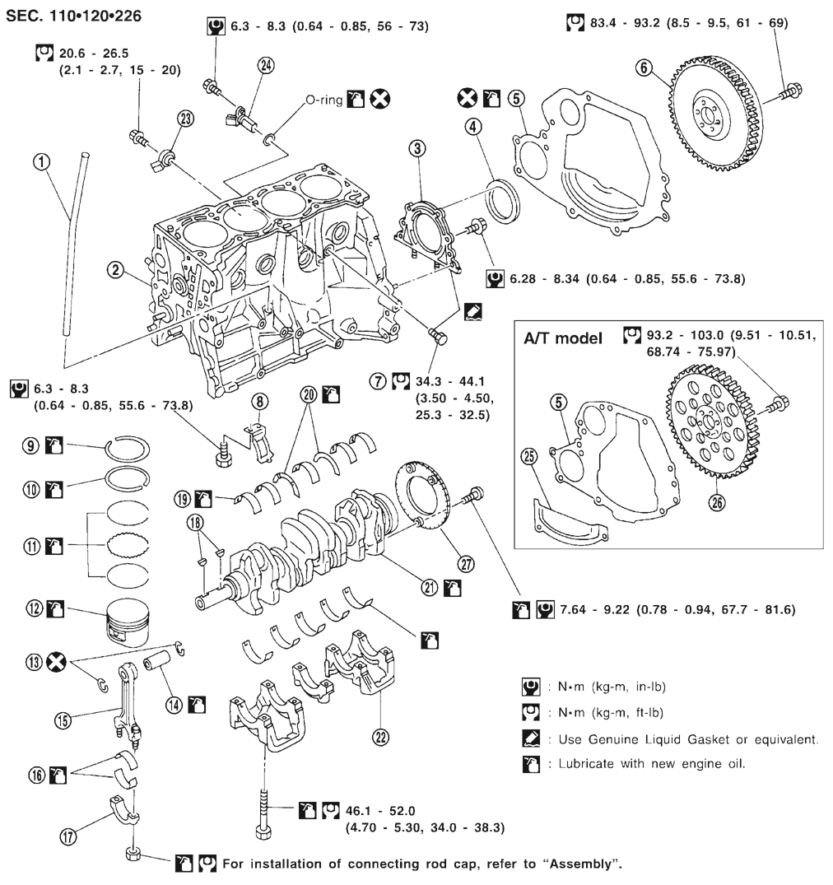
Automotive Engineering Practice
Chapter 2 Identify Different Parts And Their Functions Of Engines
Disassemble and Assemble the Engine
Crankshaft
20 Thrust Bearing
An engine thrust bearing is a specialized, high-load rotary component designed to control the axial movement (end play) of a rotating shaft, specifically supporting the crankshaft and preventing it from moving longitudinally due to force
By Ibrahim siraj
Maldives polytechnic

Slide 16
THANK YOU

